Slide 1
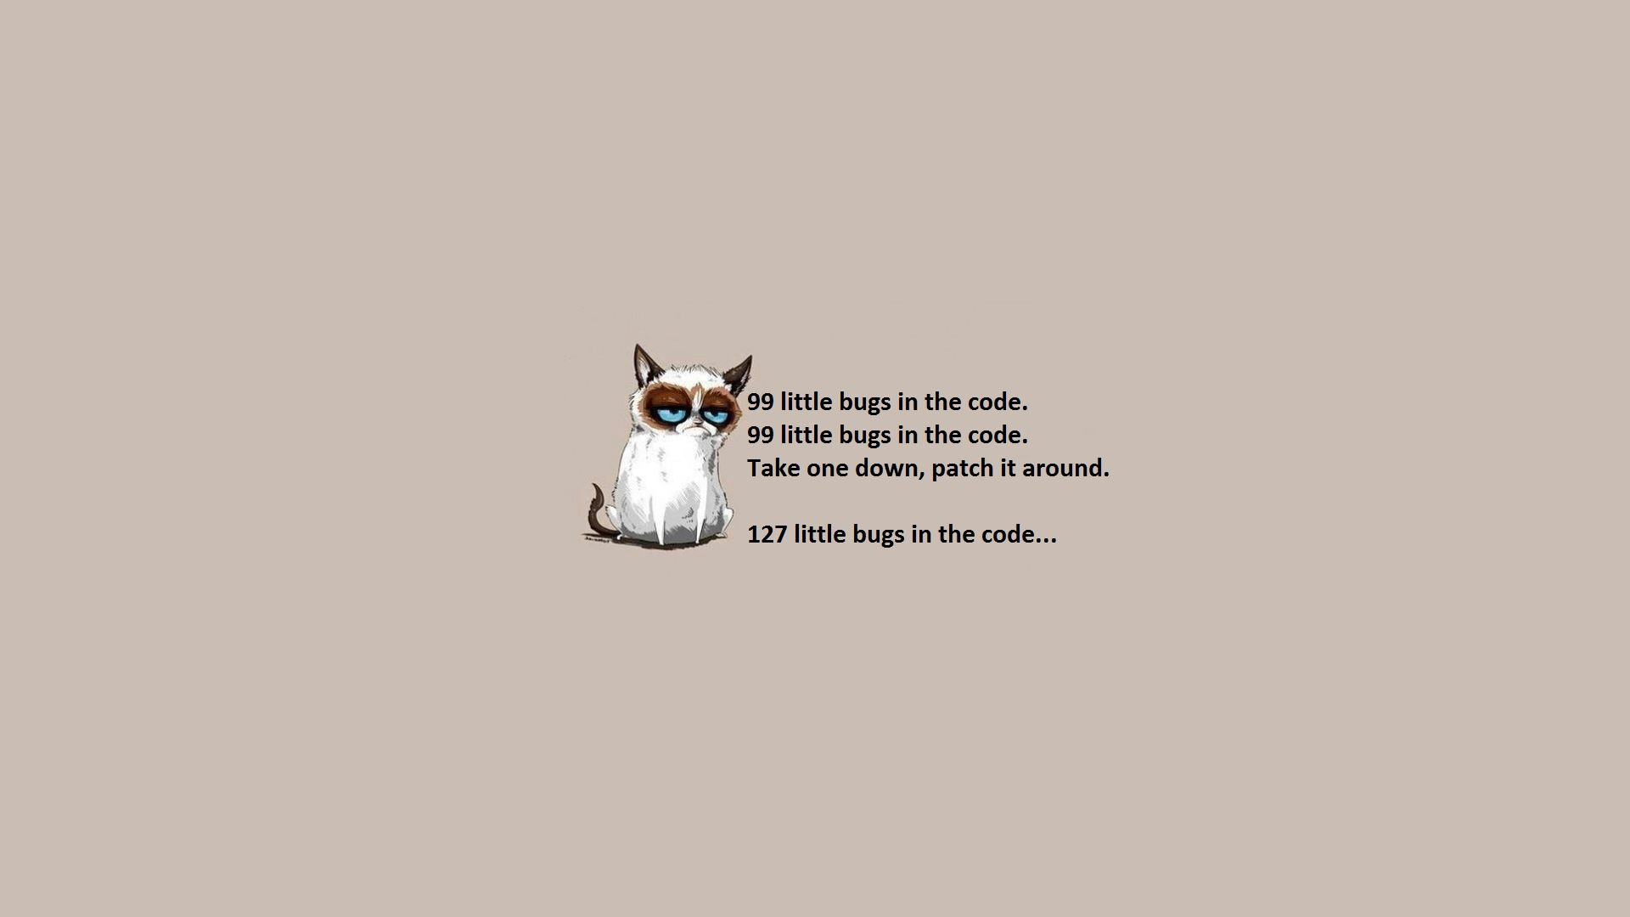
Capstone Final Presentation
WYSIWUG Tensorflow GUI

Slide 2
Instructions
Final Presentation
Process and Progress
How did we learned new technologies
What did I learn from this

Slide 3
How I learned new technologies

Slide 4
What websites were helpful? (Listed in order of helpfulness.)
Kivy(https://kivy.org/#home)
Python Manual (https://docs.python.org/3/)
Tensorflow Documentation(https://www.tensorflow.org/api_docs/python/)
1
What, if any, reference books really helped?
Dragon Book (Compilers: Principles, Techniques, and Tools (2nd Edition))
Modern Compiler Design (Worldwide Series in Computer Science) 1st Edition
2
3
Were there any people on campus that were really helpful?
TA
Client
Professors

Slide 5
What I learned from this

Slide 6
What technical information did you learn?
Time management
Concurrent development
Module testing
Programing techniques
Debugging.
1
What non-technical information did you learn
communication was required
take responsibility for critical tasks
Scalable problem solving technique:
Identifying the question
Identifying the capabilities of our tools
Learning how to look up features of our tool-set
Look at examples
Implement our own solution
Test
Debug
2

Slide 7
What have you learned about project work?
Project work is series smaller problem solving steps that accumulates over the course of time into a set of solutions that together tackle an aspect of the specific problem.
3
What have you learned about project management?
Timing, Communication and concurrency had the biggest impact in management of our project. In fact most difficult problems to solve that we faced were related to one of these elements of project management. Project management needs to be consistent and worked out from the very beginning.
4
5
What have you learned about working in teams?
Working in team is difficult. A team's effectiveness heavily depend on work load organization and task management. Some level of hierarchy is required in order for the team to function properly and being proactive is extremely important. A team-member that is constantly waiting for others to tell them what to do decreases the performance of the team. Also, pick reasonable goals in documentation. However always try to achieve a better goal and hope by time the goal is achieved, the quality is comparable with the original set goal.

Slide 8
If you could do it all over, what would you do differently?
There are several things that I would assert if I had to redo the capstone project:
Mandatory meetings: Set a weekly meeting time for all members to meet
Weekly Client meeting and emails: I would meet with the client every week going through what is done and what is not, setting ARs for next week's meeting. (Weekly checkpoints).
Spend more time researching: Our project suffered from lack of documentation for one of our APIs. It made it extremely difficult for us to et anything done. I would very much like to avoid that.
Identify each member's skills: It is important to know who is better at doing a specific task in the team. This will greatly increase efficiency in the project procedure.
Communication: Talk to teammates, TAs, Instructors and client. Many problems get solved by simply introducing a new perspective .
6

Slide 9
Visual Flow
THANK
YOU

